Slide 1
Table of Contents
01
Overview of the purpose of the project
02
Project software architecture
03
A software design decision(s)
04
A demonstration of key or interesting features
05
How your group communicated
06
Something non-technical that you learned during the project
07
Realistic plans to take this project onwards

Slide 2

01
Overview of the purpose of the project
Erick Mgawe

Slide 3

Purpose of the project
The purpose of The RefugEAP Network project is to create a website that serves as a platform to support practitioners in providing English for Academic Purposes (EAP) by facilitating sharing, collaboration, and support within the EAP community to better serve refugee-background students in accessing and benefiting from EAP provisions

Slide 4
Purpose of the project
The purpose of the project was also to help us gain experience in using the scrum framework that involved working in sprints, taking part in being the scrum master and using the scrum board. This enabled us to learn to work in teams, communicate effectively, and manage tasks and deadlines. It helped us gain an understanding of the importance of feedback and the role it plays in project development.

Slide 5

02
Project software architecture
Rasheed Khoshnaw

Slide 6
Project Software Architecture
Given the limited time due to the sprints format, we opted for something that we all had some experience with from our previous lectures.
The client required a website that had either an admin control panel or some other easy way of uploading and editing blogs. As such, we needed a framework that could take inputs, show information from a database in a website HTML format, and allow for some form of login authentication.

Slide 7
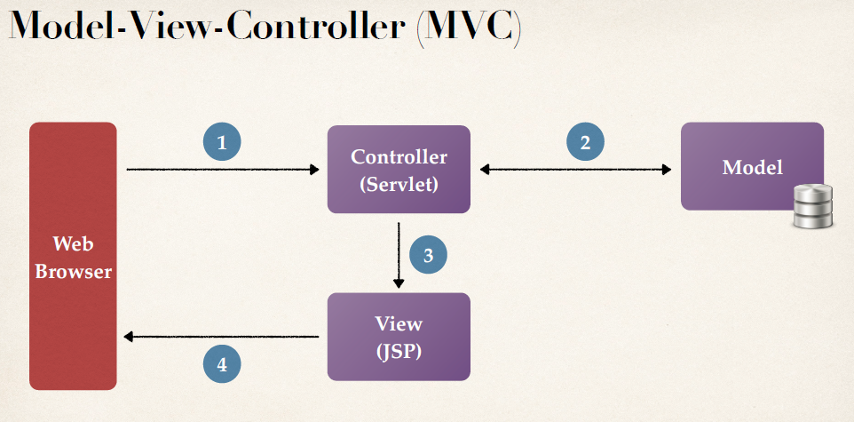
Project Software Architecture
Java Spring built with Gradle for its web and security dependencies. For the database we used MySQL Workbench and set the schemas up early on.
We used Model-View-Controller (MVC) with JSPs to display content from the refuge_db database into HTML pages.
Setup with GitLab took longer than anticipated but eventually once we found a workaround we had version control set up for our project and we carried on with this workflow till the end of the project.

Slide 8
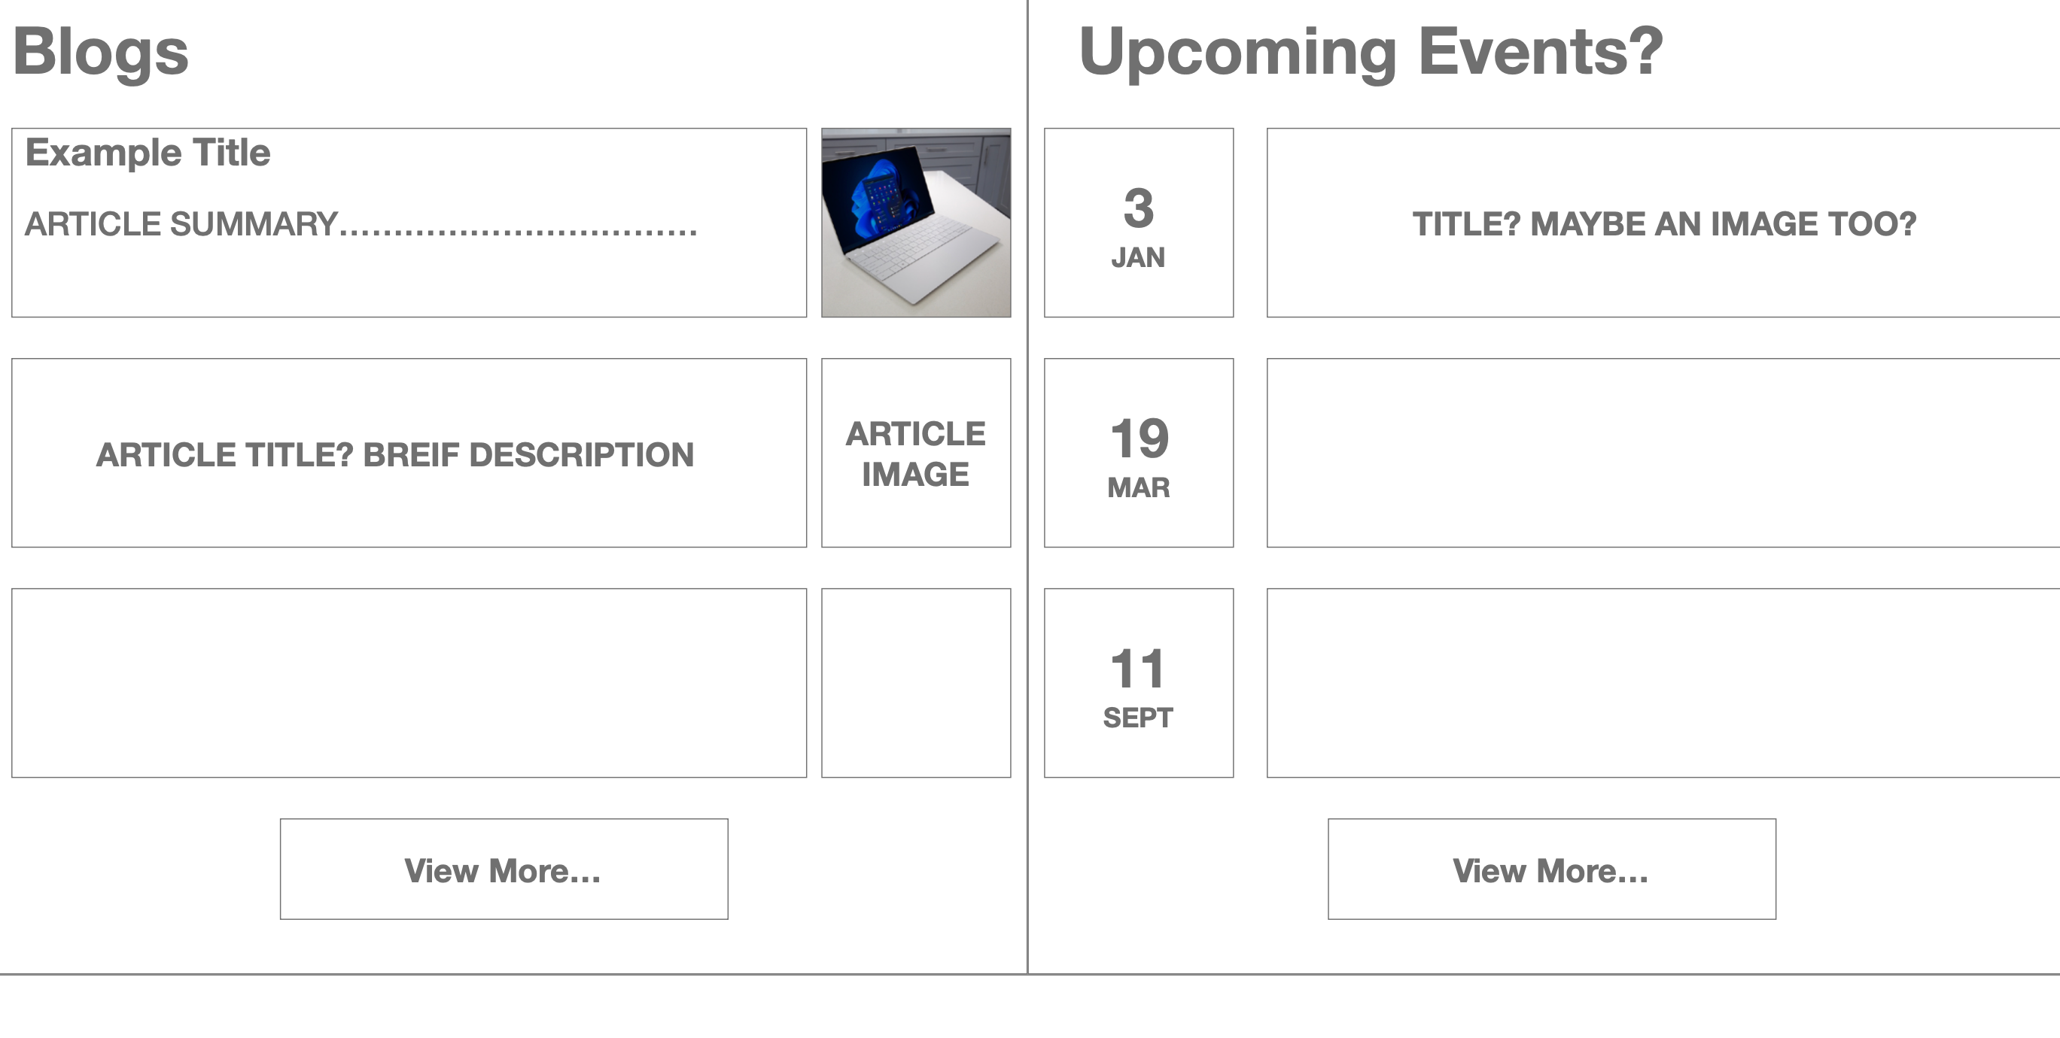
03
Software Design Decisions
Thomas Keegan

Slide 9
Considerations
•When designing the website, we had multiple considerations:
•Audience – The website will be used mainly by refugees and so needs to be easily legible and easy to use
•Accessible – This links with our intended audience as it is important the website is accessible to all, in particular to refugees
•Secure – This was a concern of the client, as many refugees are fleeing persecution and so the website needs to be safe for them to use

Slide 10
Considerations Continued…
•Easy to Maintain – The website had to be easy for a novice user to maintain and use, another concern of the client
•Intended Use Case – The website needs to contain appropriate information in a clear format, while the client provided us with content for the website it was important that any information we did put on the website was easily legible

Slide 11
Application of Considerations
•As mentioned, the considerations played a pivotal role in our choices when developing the website
•As can be seen from looking through our website there is a clear focus on ease of use and accessibility
•The website further presents the user with all required information, while still remaining easy to navigate
•I will briefly discuss this on a few of the pages

Slide 12
Home Page
•Simple, Easy to Understand & Navigate
•Provides clear structure to the user in the form of a navigation bar at the top of the page
•Each section was chosen in conjunction with the client to ensure it met their needs
•The navigation bar was later revised after the client explained their need for ‘dropdown’ options which is what ended up in the final production version of the site
•The current page that the user is on was also highlighted in the production version to further enhance the understandability of the site to the end user
•The logo is clearly visible on the page ensuring that it is clear to the end-user where they are

Slide 13
Home Page Continued…
Looking further down on the home page, there are two sections containing information on upcoming events, and recent blogs
In doing this we made information readily available to the websites user and further ensured that the user can easily navigate and understand the site
Links to the actual blog and event pages are also found here for user convenience
A short selection of these events and blogs shown here to ensure the user is not overwhelmed with information on the site
The home page also contains a view of the companies twitter feed to allow a site viewer to get quick access to up to date information from the charity themselves

Slide 14
About Us Page
The About Us page exists to provide an end user with all the information they need to understand the mission of the charity
The page contains lots of information, but it remains easy to understand
To further improve the accessibility of the website we added direct contact links to each of the members of the group, meaning all a user would have to do is click the link and immediately be taken to an email form where they can directly contact a member

Slide 15
Blog Page
The blog page follows the same principles of our website in that it promotes ease of access to the content
The page contains all the blog posts split into categories as defined by the client (Blog, Testimonials, Case Studies)
The page also contains an easy to understand form to submit a new blog, in which a practitioner or admin can approve or deny the post, improving ease of use both for the end user and for the admin

Slide 16
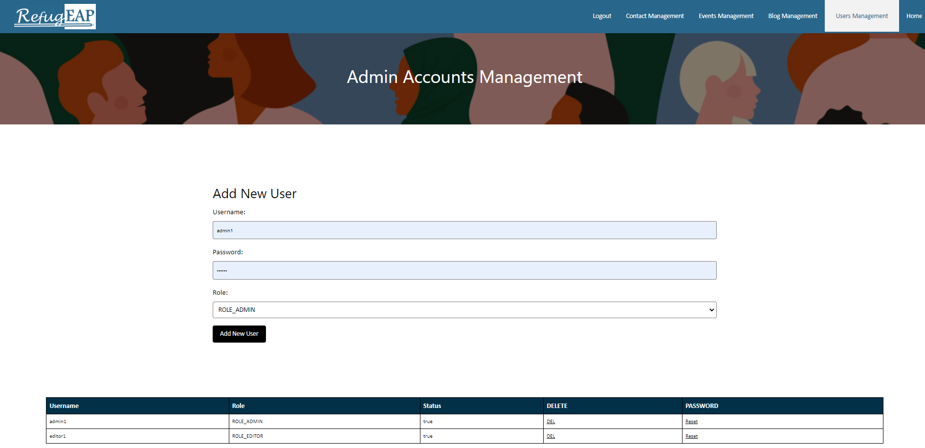
04
A demonstration of key or interesting features
Harry Chambers

Slide 17
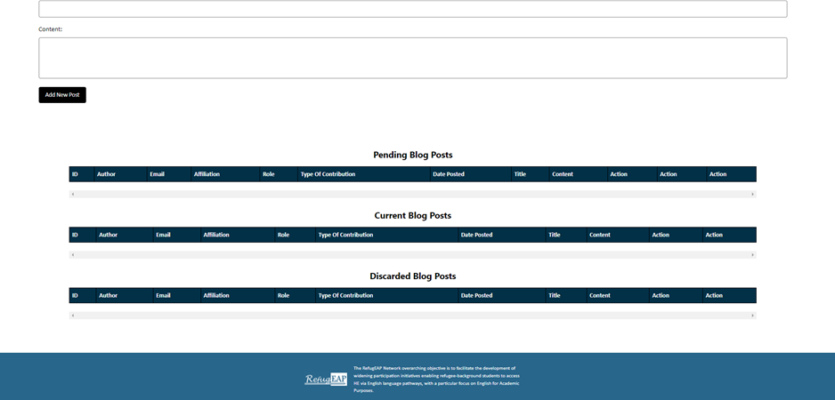
Admin side management
The Needs:
Simple/user friendly
Quick to use
Secure
The Purpose:
Manage event and blog posts
Manage contacts
Add and delete admins

Slide 18
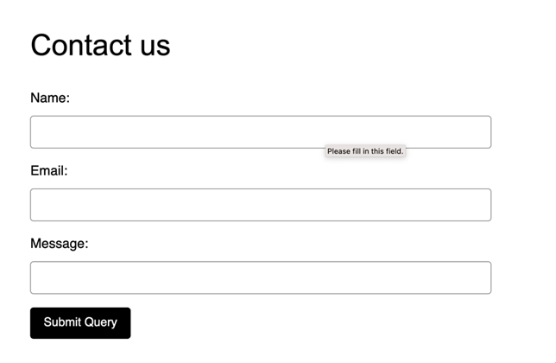
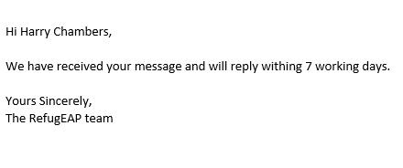
Email service
Adds more communication between the user and admins
A email is sent after every form submission
An email is sent to keep users updated regarding posts

Slide 19

05
How your group communicated and whether it worked well or not
Figure 1. Office Meeting (Child, B.)
Youssef Sadquy

Slide 20





Communication Channels & Strategies
Figure 2. Teams Logo (Microsoft Corp.)
Utilized Microsoft Teams for:
Online collaboration and file sharing
Task assignment and progress tracking
Instant messaging and group discussions
In-Person Meetings for:
Complex discussions requiring visual aids or brainstorming
Evaluating and identifying areas for improvement in
upcoming sprints
Weekly Meetings to:
Discuss individual objectives for the upcoming sprint
Evaluate progress, ensuring tasks are on track
Address challenges and provide support where needed
Figure 3. Meeting (CleanPNG)

Slide 21
Communication Effectiveness
SPRINT 4
Effective group communication played a crucial role in RefugEAP project completion:
Achieved a clear understanding of:
Roles and responsibilities for each team member
Project milestones and deadlines
Facilitated open and transparent communication:
Encouraged sharing ideas, concerns, and potential solutions
Promoted supportive and inclusive team environment
Enabled quick identification and resolution of issues:
Regular check-ins to monitor progress
SPRINT 3
COMMUNICATION EFFICIENCY
SPRINT 2
SPRINT 1

Slide 22

Overall Impact on Project Success
Group communication played a crucial role in:
RefugEAP project completion on time and within scope
High-quality product delivery that met client requirements and expectations
Team members developed essential skills:
Effective teamwork and collaboration
Strong client communication and requirement gathering
Communication learned in this project will:
Contribute to better decision-making in planning phases
Lead to more efficient and effective development processes in future projects
Figure 4. Idea (PPT)

Slide 23
REFERENCES
Figure 1 – Child, B. (2015). Minimalist Boardroom [Photograph]. Available at: https://unsplash.com/photos/GWe0dlVD9e0 (Accessed: 04/05/2023)
Figure 2 – Microsoft Corporation (2019). Microsoft Teams Logo [Photograph]. Available at: https://www.microsoft.com/en-gb/microsoft-teams/group-chat-software (Accessed: 04/05/2023)
Figure 3 – Burman (2019). Meeting Illustration [Illustration]. Available at: https://www.cleanpng.com/png-business-presentation-information-clip-art-vector-336571/ (Accessed: 04/05/2023)

Slide 24
06
Something non-technical that you learned during the project
Peter Nicholl

Slide 25

Importance of Effective Communication
Clear and open lines of communication are crucial
Ensures everyone is on the same page
Enables the team to work towards the same goals
Helps in meeting the requirements for each sprint

Slide 26

Collaboration and Goal Setting
Working collaboratively helped us achieve our objectives
Setting clear goals enabled us to focus our efforts
Ensured that everyone understood their responsibilities
Team members were able to hold each other accountable

Slide 27

Achieving Objectives Efficiently
The importance of time management in a project
Set realistic timelines for each sprint
The team worked efficiently to achieve objectives within the set timelines

Slide 28

07
Realistic plans to take this project onwards
Graham S. 2016
Nafiz MD Rahman

Slide 29
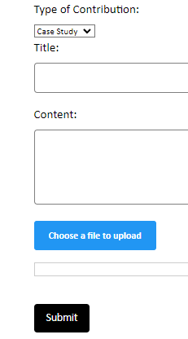
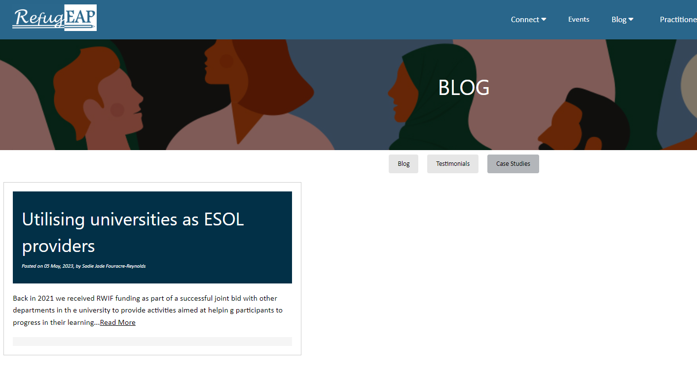
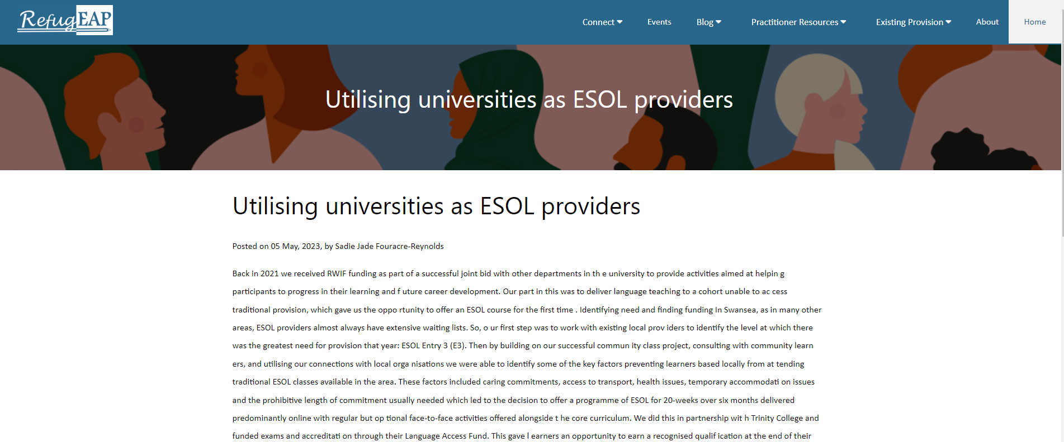
Future Improvements & Feature Expansion
Blog page can be enhanced by providing separate
page for each blog post.
Including video as a method of blog submission.
Figure 1. File Submission
Figure 2. Separate Blog Page

Slide 30
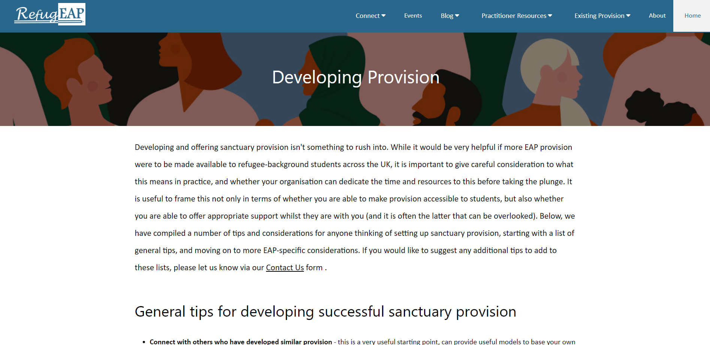
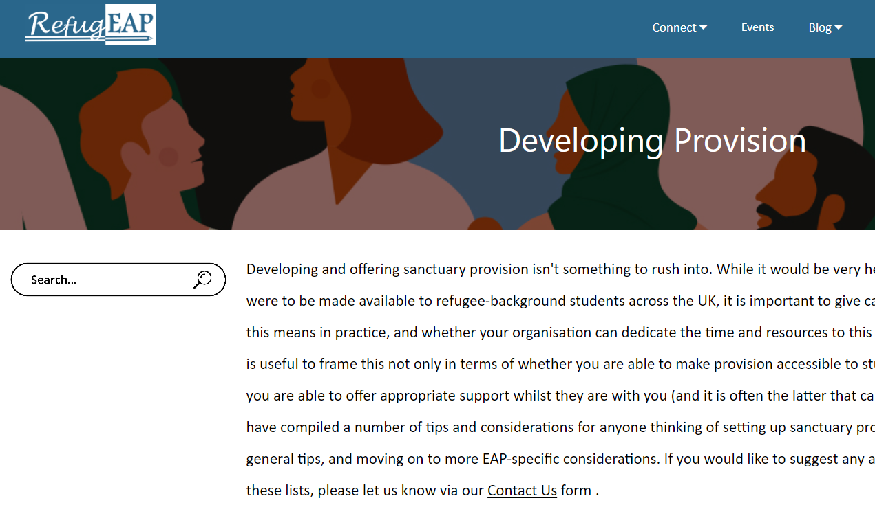
Future Improvements & Feature Expansion
Increase interactivity of the website by allowing users to leave comments on blog posts.
Implementing a search bar across all the pages
to make it easier for user.
Adding multilingual support for specific languages so that user can change the website language.
Figure 3. Search Bar

Slide 31
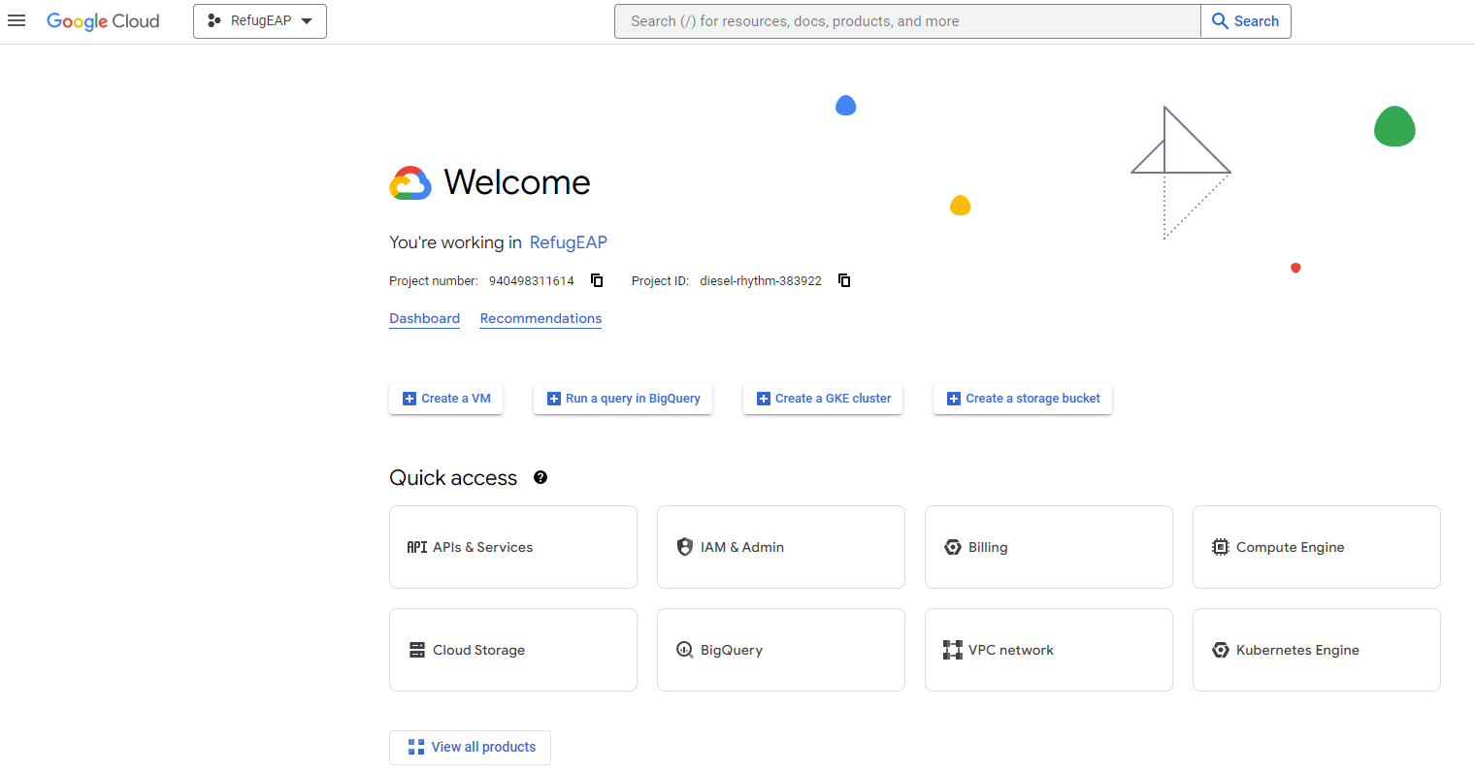
Hosting & Deployment
Discuss with clients the type of hosting and their budget.
Compiling the project code and deploying on the hosting server, creating database table to store data.
Figure 4. Google Cloud Hosting (Google Cloud)

Slide 32
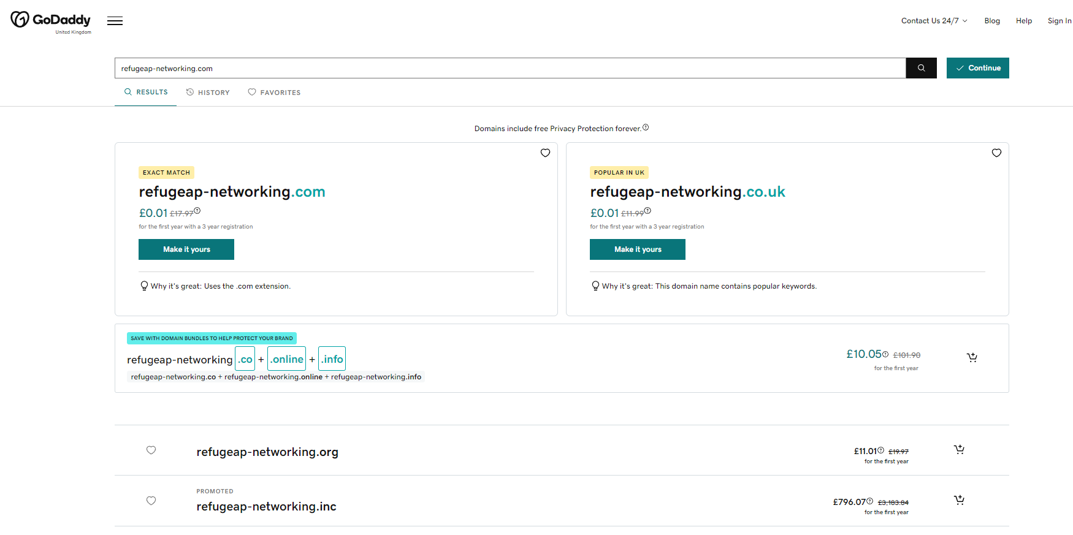
Hosting & Deployment
Purchasing a suitable domain name for the website.
Once deployed testing out the website for functionalities and performance.
Figure 5. Domain Name (GoDaddy)

Slide 33
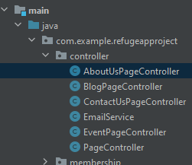
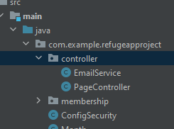
Website Management and Maintenance
Compiling all css code and forming one css file to which all jsp page will reference from.
Increasing modularity of code for page controller will increase maintainability.
Figure 6. Page Controller Class

Slide 34

Website Management and Maintenance
Producing a maintenance and troubleshooting guide for the client.
Demonstrate to client how to use admin side pages to manage the content of the website.
Figure 7. Website maintenance illustration (Hakimi Solutions n.d.)

Slide 35
References
Graham, S. (2016). Person Holding a Pencil [Digital Image]. Available at: https://unsplash.com/photos/5fNmWej4tAA [Accessed 3 May 2023]
Google Cloud. Web hosting solutions. [online] Available at: https://cloud.google.com/solutions/web-hosting [Accessed 4 May 2023].
GoDaddy. Domain Names. [online] Available at: https://www.godaddy.com/en-uk [Accessed 4 May 2023].
Hakimi Solutions. (n.d.). A guide to choosing a website maintenance partner. [Blog post]. Available at: https://hakimisolutions.com/blog/guide-to-choose-website-maintenance-partner/ [Accessed 4 May 2023]

